Slide 1
PANTAU COVID -19
Group 2
Name of Members :
Hanas Bayu Pratama
Muhammad Dani Setiawan

Slide 2
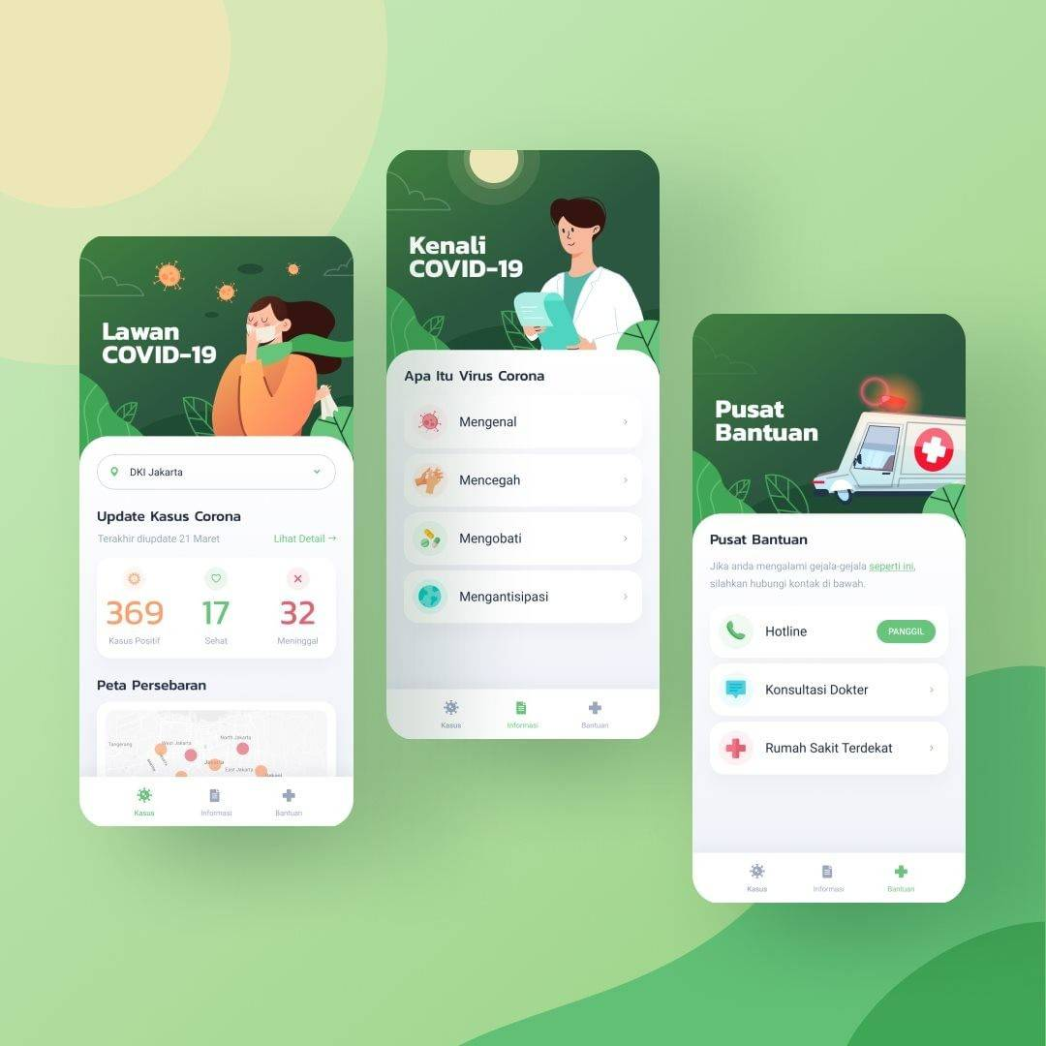
User Interface

